Slide 1



www.texasincomeprotectionplan.com
Texas Income Protection PlanSM
Short-term and long-term disability insurance for active employees
TIPP is administered by Alight Solutions.
Notes:
[PRESENTER]
Hello, this presentation will tell you about the Texas Income Protection PlanSM (TIPP), which is short-term and long-term disability coverage offered only to active employees (not to family members or retirees). TIPP is administered by Alight Solutions. You can find more information on www.texasincomeprotectionplan.com.
<NEXT SLIDE>

Slide 2
Ask Yourself …
What would happen if you couldn’t work due to an illness, injury or pregnancy?
Would paying your bills be stressful?
Would you have to use your savings?
Among working Americans:
TIPP can help!
Disability coverage protects a portion of your income to help pay your bills and focus on your health.
¹ Life and Health Insurance Foundation for Education
1 in 5 | People can expect to be out of work for at least 1 year because of a disabling condition before they reach retirement age.¹ | 90% | Of all workers consider their ability to earn an income as their most important financial resource¹
Notes:
What would happen if you became disabled and did not receive a paycheck? Or are you considering pregnancy/maternity leave?
Would paying your rent or mortgage and other bills be stressful?
Would you have to use your savings?
Consider this:
More than one in five of today’s 20-year-olds can expect to be out of work for at least a year because of a disabling condition before they reach the normal retirement age
Only 48 percent of American adults indicate they have enough savings to cover three months of living expenses in the event they’re not earning any income
¹ Life and Health Insurance Foundation for Education
The answer may be TIPP.
Disability coverage provides you a percentage of your paycheck when you can’t work due to illness, injury or pregnancy. So let TIPP’s coverage help you pay your bills and let you focus on getting better.

Slide 3
TIPP Overview
Coverage for Plan Year 2027
Coverage Detail | Short-Term Disability Coverage | Long-Term Disability Coverage
Monthly amount the participant will receive | 66% of your monthly salary up to $10,000 of salary | 60% of your monthly salary up to $10,000 of salary
Length of benefits | Up to five and a half months (a maximum of 166 days) after the completion of your waiting period. | Until you are able to return to work or until you reach your Maximum Benefit Period (based on the age you become disabled) or based on the condition causing your disability.
Timeframe until the participant’s benefits start | You complete a waiting period of 14 consecutive days and at the same time use all your sick leave. | You complete a waiting period of 180 consecutive days and at the same time use all your sick leave.
Integration of benefits | TIPP benefits are reduced if you get other disability payments. The minimum benefit is 10% of your monthly salary.
Claims | After your first six months of coverage, file your disability claims as soon as possible but within a year from the first day of your disability. You have two options to file your claims: Use the online self-service option at www.texasincomeprotectionplan.com or call TIPP Customer Care at (855) 604-6230 (TTY - 711), Monday - Friday, 7 a.m. - 7 p.m. CT.
Notes:
[PRESENTER]
Let’s start out with an overview of the short-term and long-term disability coverage offered by TIPP for Plan Year 2027 (effective Sept. 1, 2026).
Short-term disability provides 66% of your insured monthly salary up to a maximum of $10,000, not to exceed a maximum benefit of $6,600 per month. As long as you’re disabled, payments last up to five and a half months (a maximum of 166 days) after completion of your waiting period. Example: If your insured monthly salary is $3,200, your monthly STD payment would be $2,112 ($3,200x66%=$2,112).
Long-term disability provides 60% of your insured monthly salary up to a maximum of $10,000, not to exceed a maximum benefit of $6,000 per month. Until you are able to return to work or until you reach your Maximum Benefit Period (based on the age you become disabled) or based on the condition causing your disability. Example: If your insured monthly salary is $3,200, your monthly LTD payment would be $1,920 ($3,200x60%=$1,920).
Before benefit payments can start, you must complete a waiting period as shown in the chart and at the same time use all your sick leave (including extended sick leave, donated sick leave and/or sick leave pool). The waiting period for short-term disability coverage was reduced to 14 consecutive days. The reduced waiting period allows you to begin receiving disability payments sooner, such as for participants with limited sick leave.
Your sick leave use and waiting period occur at the same time. You cannot “freeze” your sick leave. If you have more sick leave than the specified days of the waiting period, benefits are not payable until all your sick leave is used. However, you are not required to use your vacation or other annual leave.
Please note leave hours are not managed by ERS or TIPP. Contact your HR department for leave questions.
If you receive disability payments from other sources, such as Social Security disability or Workers’ Compensation, TIPP benefit payments are reduced. This will also apply to members that are paid short-term and long-term disability benefits simultaneously.
After your first six months of coverage, file your disability claims as soon as possible but within a year from the first day of your disability.
You can file your disability claim in one of two ways:
Online using the self-service option at www.texasincomeprotectionplan.com, or
Call TIPP Customer Care
<NEXT SLIDE>

Slide 4
TIPP Overview (continued)
Premium Costs
Coverage | Costs for Plan Year 2027 Same as Plan Year 2026
Short-term disability | $0.24 cents per $100 of monthly salary
Long-term disability | $0.63 cents per $100 of monthly salary
Notes:
[PRESENTER]
There are no premium changes for Plan Year 2027. The premium cost for short-term disability will remain at $0.24 cents per $100 of monthly salary. The premium cost for long-term disability will remain at $0.63 cents per $100 of monthly salary.
<NEXT SLIDE>

Slide 5
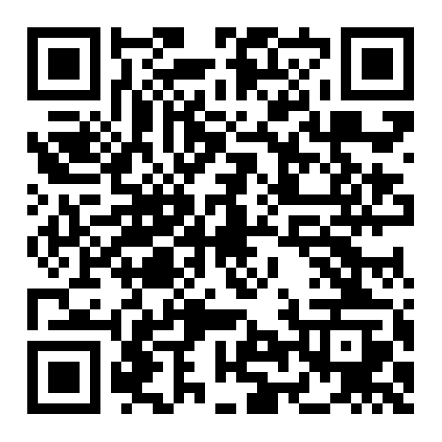
Limitations and Exclusions
Like most disability plans, TIPP has certain limitations and exclusions, or rules, when disability benefits wouldn’t be payable.
Scan the QR code to view the Limitations and Exclusions webpage on the TIPP website.
Notes:
[PRESENTER]
Like most disability plans, TIPP has certain limitations and exclusions, or rules, when disability benefits wouldn’t be payable.
Please reference the Limitations and Exclusions webpage located on the TIPP website for more information.
Are you considering pregnancy? Well next, I will share how paid parental leave for state agency employees and short-term disability coverage support eligible maternity claims.
<NEXT SLIDE>

Slide 6
For state agency employees: disability coverage and paid parental leave
What is paid parental leave?
40 days of paid parental leave under Texas Government Code § 661.9125.
Paid parental leave does not count against TIPP benefits.
Paid parental leave is administered by the employee’s agency.
Employees should contact their benefits coordinator (HR department) for questions about FMLA and paid parental leave.
Notes:
What is paid parental leave? State employees who are eligible for Family and Medical Leave Act (FMLA) leave due to the birth of a child are also entitled up to 40 days of paid parental leave under Texas Government Code § 661.9125. Paid parental leave does not count against TIPP benefits. Paid parental leave is administered by the employee’s agency. Employees should contact their benefits coordinator (HR department) for questions about FMLA and paid parental leave.
[Next slide]

Slide 7
For state agency employees: disability coverage and paid parental leave – continued
Paid parental leave and TIPP (maternity leave)
Receive short-term disability benefits for maternity leave and paid parental leave at the same time.
TIPP coverage can be up to six weeks for a vaginal birth and up to eight weeks for a cesarean birth, with extensions allowed for complications.
Notes:
The Texas Income Protection Plan (TIPP) considers maternity leave as a temporary medical disability. TIPP participants could receive short-term disability benefits for maternity leave and paid parental leave at the same time. To qualify for the TIPP benefits, the pregnancy must start after TIPP coverage begins and participants must complete their waiting period and use all sick leave. TIPP coverage can be up to six weeks for a vaginal birth and up to eight weeks for a cesarean birth, with extensions allowed for complications. So, TIPP can especially be a great benefit for employees who are considering pregnancy.
Now, let’s look at an illustration of an eligible maternity claim.
[Next slide]

Slide 8
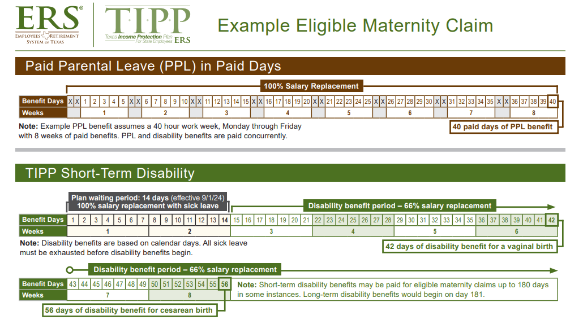
Notes:
In the illustration, it shows an eligible state agency employee who works a 40-hour work week, Monday through Friday and is eligible to receive paid parental leave. This employee is also eligible to receive TIPP benefits for a maternity claim once they complete their waiting period and exhaust their sick leave. Therefore, they could receive both paid parental leave and short-term disability benefits.
In the illustration, the employee is receiving paid parental leave while they complete their 14-day waiting period and exhaust all sick leave for 100% salary replacement. Starting on day 15, they have completed their waiting period and exhausted all sick leave; therefore, the disability benefit period will begin for a 66% salary replacement. As a reminder, all sick leave must be exhausted before disability benefits begin. TIPP’s short-term disability benefit will pay up to 42 days (six weeks) for vaginal births, and up to 56 days (eight weeks) for cesarean births, with extensions allowed for complications. Long-term disability benefits would begin on day 181.
[Next slide]

Slide 9
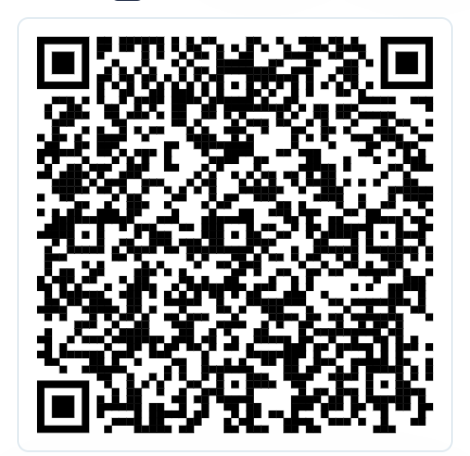
Apply for TIPP during your two-week Summer Enrollment phase in three easy steps
Log in to your ERS OnLine account at ers.texas.gov/my-account-login.
Select short-term and/or long-term disability coverage.
Complete the evidence of insurability (EOI) process.
  EOI is used to determine eligibility for disability coverage. You will receive instructions on how to submit your EOI application.
Scan the QR code to link to view the Summer Enrollment Fact Sheet.
Notes:
[PRESENTER]
Now that you know how TIPP can protect your income during a disability and for eligible maternity claims, let’s go over the application process.
Applying for TIPP during Summer Enrollment can be done in three easy steps:
Apply during your two-week Summer Enrollment phase by logging in to your ERS online account at ers.texas.gov/my-account-login.
Select if you want short-term and/or long-term disability coverage.
Complete the evidence of insurability (EOI) process.
EOI is used to determine eligibility for disability coverage. You will receive instructions on how to submit your EOI application.
I’ll explain more about EOI in the next slide.
<NEXT SLIDE>

Slide 10
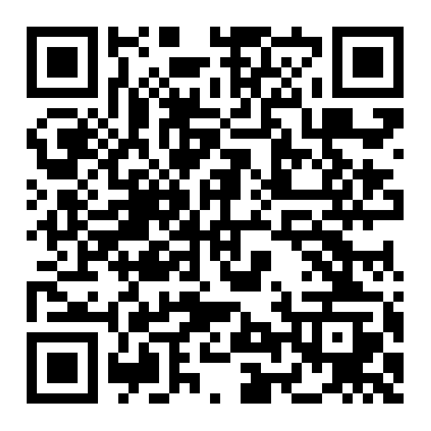
Evidence of Insurability (EOI)
EOI is used to determine eligibility for TIPP coverage.
EOI is required when you apply during your two-week Summer Enrollment phase.
You must start your EOI process through your personal ERS OnLine account. Photocopies are not accepted.
EOI must be submitted by the last day of Summer Enrollment.
Your application must be approved before coverage begins. Approval is not guaranteed.
Scan the QR code to view the EOI webpage on the TIPP website.
Notes:
[PRESENTER]
Evidence of insurability (EOI) is used to determine your eligibility for coverage.
EOI is not required if you apply during your first 31 days of employment but is required when you apply during your two-week Summer Enrollment phase.
You must start the EOI process through your personal ERS OnLine account. Photocopies are not accepted.
You will be in contact with the underwriter, who processes the EOI applications. Please open any correspondence from them.
Your application must be approved before coverage begins.
Note: Approval is not guaranteed.
-If approved before September 1 (the first day of the new plan year), your coverage starts September 1.
-If approved on or after September 1, your coverage will start the first day of the month following the EOI approval date.
<NEXT SLIDE>

Slide 11
Your Resources
TIPP Customer Care:
  Toll-free at (855) 604-6230 (TDD - 711),
  Monday - Friday, 7 a.m. - 7 p.m. CT
  Learn about TIPP
  Start or follow up on a claim
TIPP Self-Service:
  Located on the top of the TIPP website
  Submit a claim
  Get information on an existing claim
  Upload claim documentation
Notes:
[PRESENTER]
You can call TIPP Customer Care toll-free at (855) 604-6230 (TDD - 711), Monday through Friday, from 7 a.m. to 7 p.m. CT.
You’ll be able to get all of your income protection questions answered, even if you are not enrolled in TIPP yet.
Plan participants can start or follow up on a claim.
You can also use our self-service feature located on www.texasincomeprotectionplan.com, 24 hours a day, seven days a week.
Click on the self-service link at the top-right
From there you can submit a claim
Get information about an existing claim, and
Upload claim documentation
<NEXT SLIDE>

Slide 12
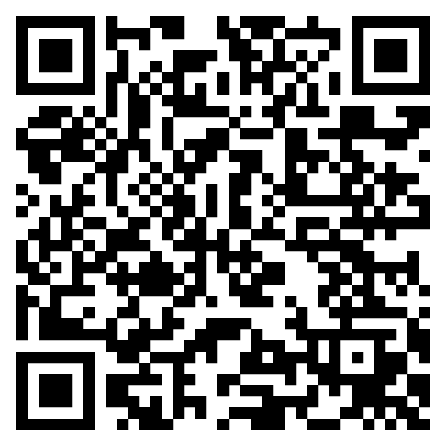
Your Resources
TIPP website:
One stop for TIPP information
Self-Service Portal
TIPP Summer Enrollment materials
Detailed plan documents
EOI information
Limitations and exclusions
  www.texasincomeprotectionplan.com
Notes:
[PRESENTER]
Visit the TIPP website for other resources, such as the Self-Service Portal, Summer Enrollment materials, detailed plan documents, EOI information and the limitations and exclusions of coverage, and more.
Reminder that the TIPP website and materials will continue to be updated as needed for the new plan year.
<NEXT SLIDE>

Slide 13

Notes:
[PRESENTER]
Thank you for taking the time to learn more about the Texas Income Protection Plan. We look forward to protecting your income!
[END - Intro to Q&A session]

